Slide 1

Classification Problem and Decision Tree
Module 6CM521: Frontiers in AI and Data Science
Ioannis Tsioulis (MC)
Slides acknowledgements:
Dr Aaisha Makkar

Slide 2
Declaration
These slides are organised based on Chapter 8 in book Data Mining Concept and Techniques. Other online resources that help to create the slides are referenced at the end.
Acknowledgement
Most of the slides are adapted from the lecture slides of Dr Hong Qing Yu (Harry).

Slide 3
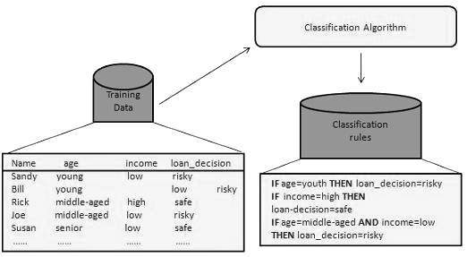
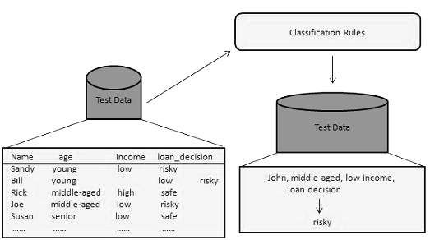
Classification problems in machine learning
The task of classification is to use a machine learning algorithm that learn how to assign a class label to the training dataset and provide good performance on testing dataset from a specific problem domain.
General approach:
Step1
Step2

Slide 4
Different types of classification problems
From label size or property point of view, there are 4 different classification problems
  Binary classification
  Multi-class classification
  Multi-label classification
  Imbalanced classification

Slide 5
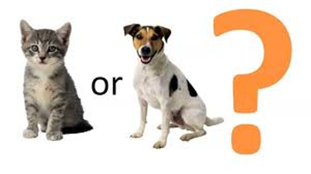
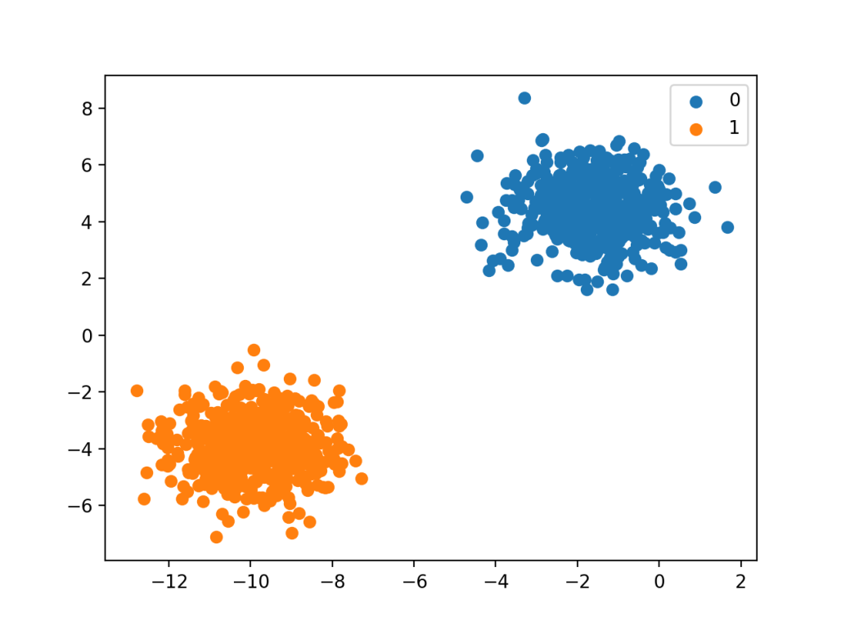
Binary Classification
Binary classification refers to those classification tasks that have only two class labels. Typically, binary classification tasks involve one class that is the normal state and another class that is the abnormal state.
Examples include:
  Email spam detection (spam or not).
  Churn prediction (churn or not).
  Conversion prediction (buy or not).
Popular algorithms
  Logistic Regression
  k-Nearest Neighbours
  Decision Trees
  Support Vector Machine
  Naive Bayes

Slide 6
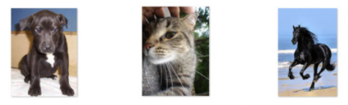
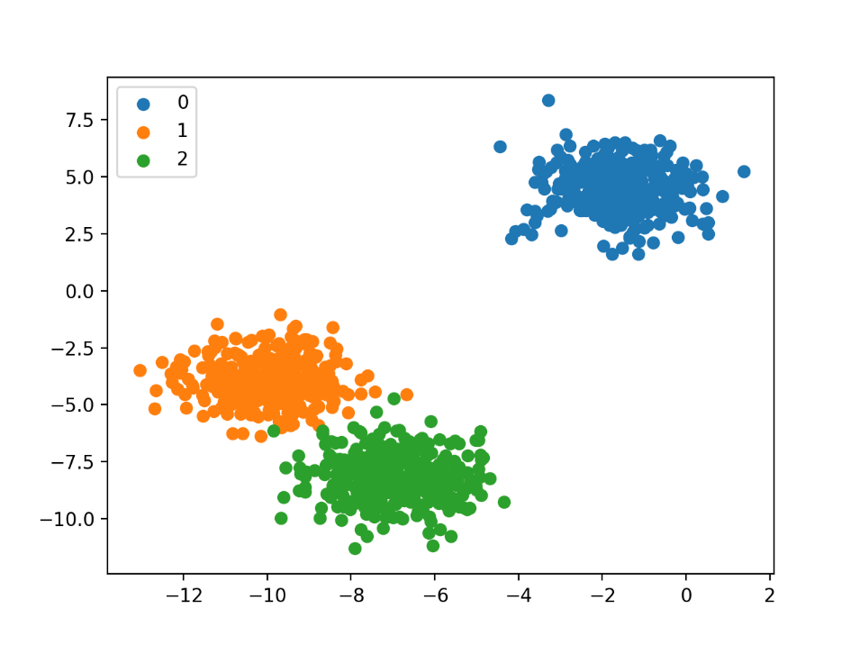
Multi-Class Classification
Multi-Class Classification refers to those classification tasks that have more than two class labels.
Examples include:
  Face classification.
  Plant species classification.
  Optical character recognition.
Popular algorithms:
  k-Nearest Neighbours.
  Decision Trees.
  Naive Bayes.
  Random Forest.
  Gradient Boosting.
Notes:
Unlike binary classification, multi-class classification does not have the notion of normal and abnormal outcomes. Instead, examples are classified as belonging to one among a range of known classes. The number of class labels may be very large on some problems. For example, a model may predict a photo as belonging to one among thousands or tens of thousands of faces in a face recognition system.

Slide 7
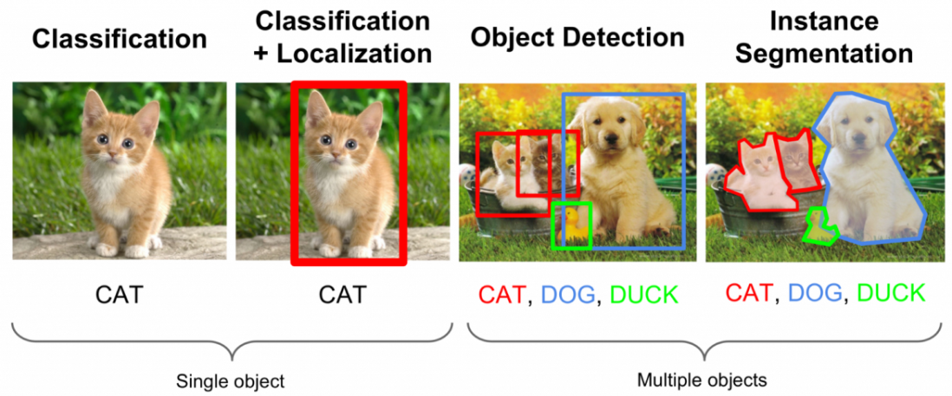
Multi-Label Classification
Multi-Label Classification refers to those classification tasks that have two or more class labels, where one or more class labels may be predicted for each example.
Consider the example of photo classification, where a given photo may have multiple objects in the scene and a model may predict the presence of multiple known objects in the photo, such as “bicycle,” “apple,” “person,” etc.
Specialized versions of standard classification algorithms needs to be implemented, so-called multi-label versions of the algorithms, including:
  Multi-label Decision Trees
  Multi-label Random Forests
  Multi-label Gradient Boosting

Slide 8
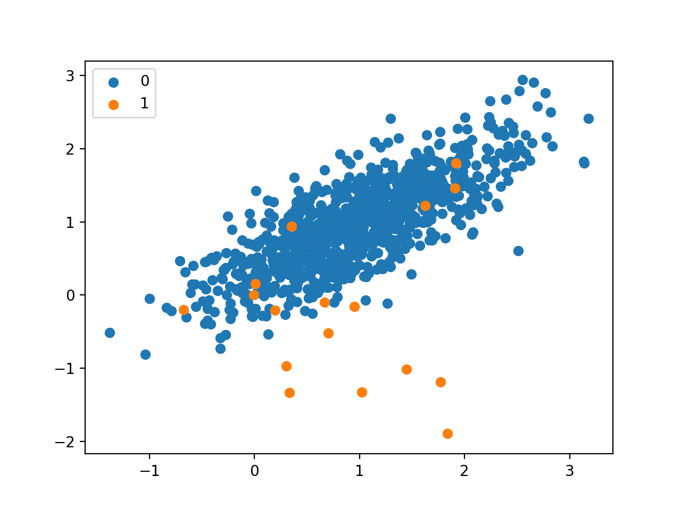
Imbalanced Classification
Imbalanced Classification refers to classification tasks where the number of examples in each class is unequally distributed.
Random Undersampling:
Random Oversampling: Randomly duplicate examples in the minority class.
Random Undersampling: Randomly delete examples in the majority class.
SMOTE Oversampling: duplicating examples from the minority class

Slide 9
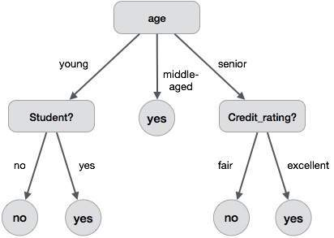
Decision Tree (Induction/Learning)
Decision tree induction is one of the simplest, and yet most successful forms of learning algorithm for solving classification problem.
It also serves as a good introduction to the area of inductive learning in AI domain.
See example
The benefits:
It does not require any domain knowledge.
It is easy to comprehend.
The learning and classification steps of a decision tree are simple and fast.
Notes:
A decision tree is a structure that includes a root node, branches, and leaf nodes. Each internal node denotes a test on an attribute, each branch denotes the outcome of a test, and each leaf node holds a class label. The topmost node in the tree is the root node.
The following decision tree is for the concept buy_computer that indicates whether a customer at a company is likely to buy a computer or not. Each internal node represents a test on an attribute. Each leaf node represents a class.

Slide 10
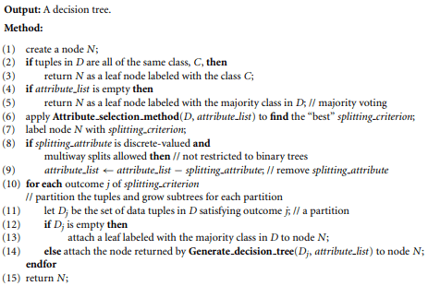
Decision Tree Basic Algorithm: construction and output
Buy_computer decision tree

Slide 11
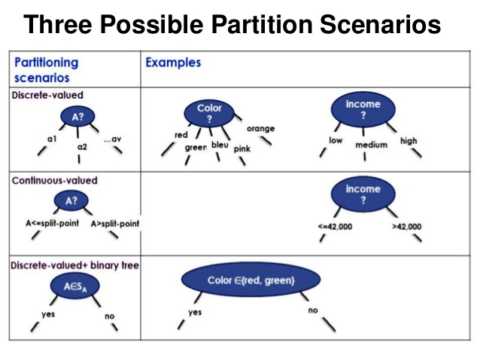
Partitioning

Slide 12
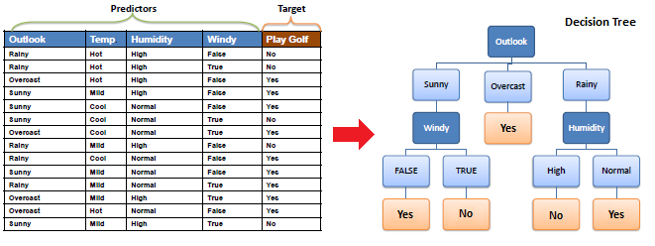
Think (Can you do another DT?)

Slide 13
Attribute Select Measures
An attribute selection measure is a heuristic for selecting the splitting criterion that “best” separates a given data partition, D, of class labelled training tuples into individual classes.
Ideally ‒ Each resulting partition would be pure ‒ A pure partition is a partition containing tuples that all belong to the same class.
Attribute selection measures (splitting rules) ‒ Determine how the tuples at a given node are to be split ‒ Provide ranking for each attribute describing the tuples ‒ The attribute with highest score is chosen ‒ Determine a split point or a splitting subset
There are around 30 different methods for attribute select measures (please see a benchmark evaluation report about their performance in reading materials section)
Notes:
How to choose An Attribute? • An attribute selection measure is a heuristic for selecting the splitting criterion that “best” separates a given data partition, D, of class labeled training tuples into individual classes. Ideally ‒ Each resulting partition would be pure ‒ A pure partition is a partition containing tuples that all belong to the same class • Attribute selection measures (splitting rules) ‒ Determine how the tuples at a given node are to be split ‒ Provide ranking for each attribute describing the tuples ‒ The attribute with highest score is chosen ‒ Determine a split point or a splitting subset • Methods – Information gain (ID3 (Iterative Dichotomiser 3) /C4.5) – Gain ratio – Gini Index (IBM IntelligentMiner) Attribute Selection Measures

Slide 14
Well known measuring methods
Information Gain
Gain Ratio
Gini Index
Before introducing the methods, we need to know a definition: “Entropy” - Shannon's metric of "Entropy" of information is a foundational concept of information theory.

Slide 15
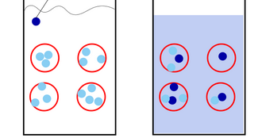
Entropy in physics
In statistical mechanics, entropy is an extensive property of a thermodynamic system. It quantifies the number Ω of microscopic configurations (known as microstates) that are consistent with the macroscopic quantities that characterize the system (such as its volume, pressure and temperature). ^{Wiki}
Ink
Entropy increased
Notes:
Ink molecular

Slide 16


Entropy in information theory
Entropy is a measure of the average information content one is missing when one does not know the value of the random variable.
  Shannon's metric of "Entropy" of information is a foundational concept of information theory.
  The entropy of a variable is the "amount of information" contained in the variable.
High Entropy
  X is from a uniform like distribution
  Flat histogram
  Values sampled from it are less predictable
Low Entropy
  X is from a varied (peaks and valleys) distribution
  Histogram has many lows and highs
  Values sampled from it are more predictable
Tenet film 2020
Entropy 1999

Slide 17
Information Gain Method
The information gain is based on the decrease in entropy after a dataset is split on an attribute. Constructing a decision tree is all about finding attribute that returns the highest information gain (i.e., the most homogeneous branches).
It has 2 steps

Slide 18
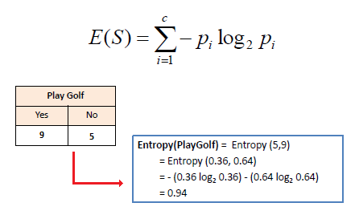
First step: 2-types of entropy computation
Entropy using the frequency table of one attribute:
A math explanation
5:14

Slide 19
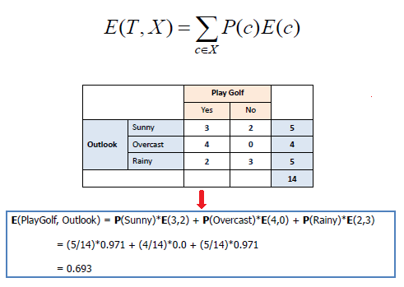
2-types of entropy computation
b) Entropy using the frequency table of two attributes:

Slide 20
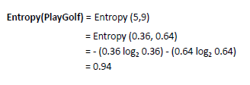
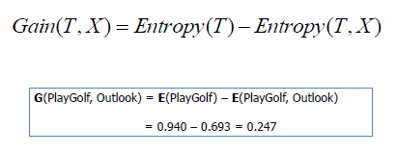
Second Step: Information Gain Computation steps:
Step 1: Calculate entropy of the target:
Step 2 : The dataset is then split on the different attributes. The entropy for each branch is calculated. Then it is added proportionally, to get total entropy for the split. The resulting entropy is subtracted from the entropy before the split. The result is the Information Gain, or decrease in entropy.

Slide 21
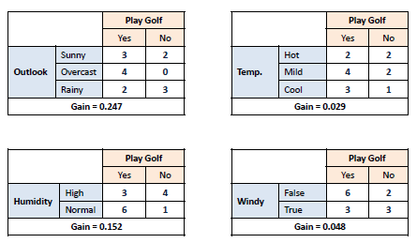
Information Gain Steps:
Step 3: Choose attribute with the largest information gain as the decision node, divide the dataset by its branches and repeat the same process on every branch.

Slide 22
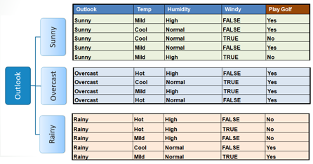
Information Gain Steps:
Step 4: loop the process to find all leaf nodes

Slide 23
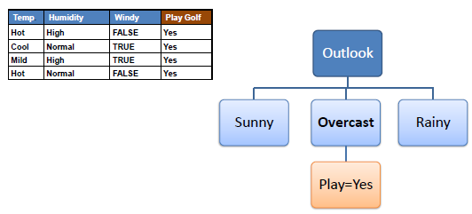
Information Gain Steps:
Step 4a: A branch with entropy of 0 is a leaf node.

Slide 24
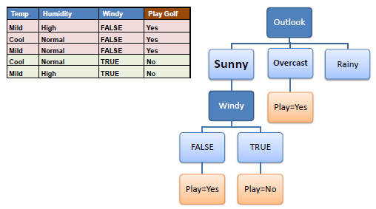
Information Gain Steps:
Step 4b: A branch with entropy more than 0 needs further splitting.

Slide 25
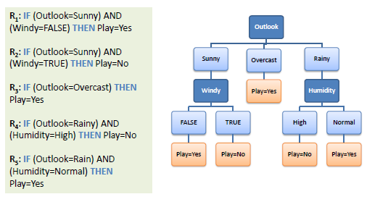
Information Gain steps:
Finalised the decision tree and it can be easily transformed to become rules

Slide 26
ID3
ID3 is an implementation decision tree constructive algorithm based completely on information gain process
1. Use existed ID3 library:
pip install decision-tree-id3
>>> from sklearn.datasets import load_breast_cancer
>>> from id3 import Id3Estimator
>>> from id3 import export_graphviz
>>> bunch = load_breast_cancer()
>>> estimator = Id3Estimator()
>>> estimator.fit(bunch.data, bunch.target)
>>> export_graphviz(estimator.tree_, 'tree.dot', bunch.feature_names)
2. Implement ID3 yourself:
https://medium.com/@lope.ai/decision-trees-from-scratch-using-id3-python-coding-it-up-6b79e3458de4

Slide 27
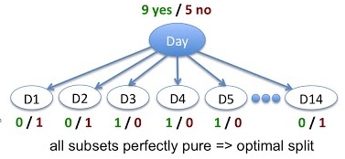
Issue of information gain
Information gain is a good measure but it has some flaws that we need to understand
If we split our dataset on Day attribute then we ended with the singleton subsets. That is on each day will either play or not.
E.g. D=15?
Not work

Slide 28
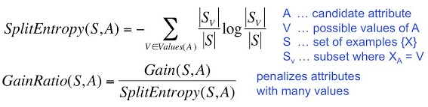
Gain Ratio
Punishing the many splitting attributes with gain ration

Slide 29
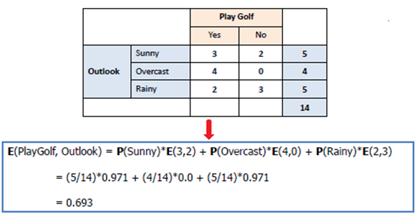
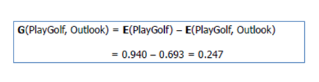
Gain Ratio (Cont.)
Entropy (S, A)
SplitEntropy (S, A)
= -5/14*log(5/14)+ -4/14*log(4/14)+ -5/14*log(5/14)
= 1.577
GainRatio (S, A)
= Gain(S, A)/SplitEntropy(S, A)
=0.247/1.577
= 0.157
Gain (S, A) = Entropy (S)- Entropy(S,A)

Slide 30
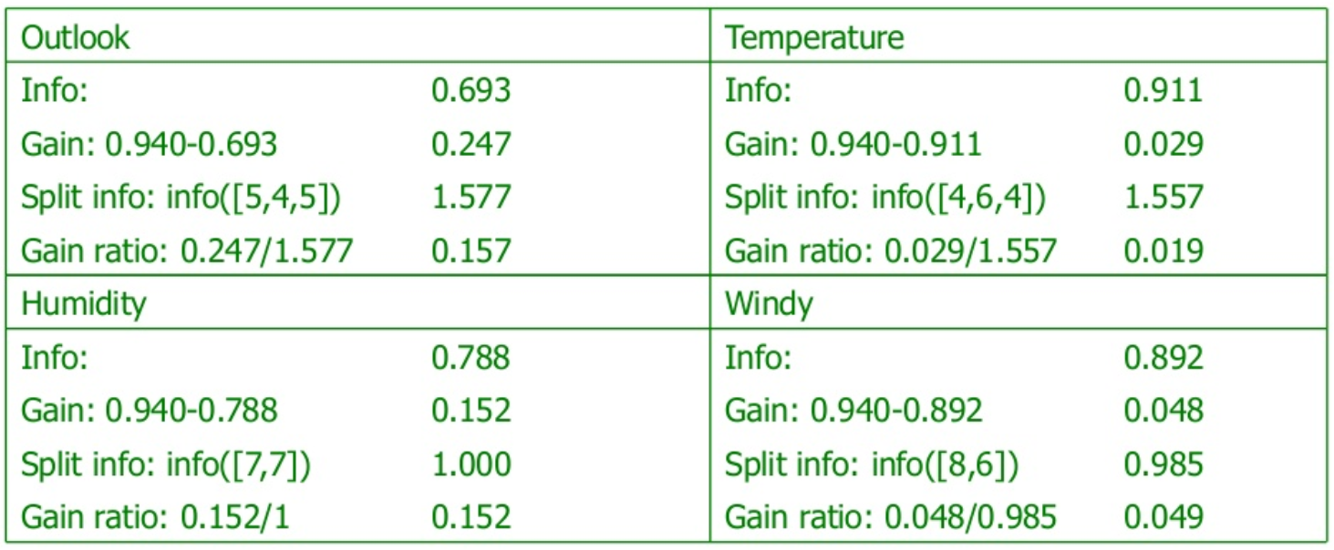
Gain Ratio results

Slide 31
Gain Ratio potential issue and C4.5
It may overcompensate. May choose an attribute just because its intrinsic information is very low.
Standard fix: only consider attributes with greater than average information gain
C4.5 is the implemented Gain Ration algorithm, a successor of ID3 with more functions of deals with numeric attributes, missing values and noisy data.

Slide 32

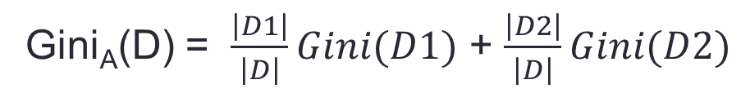
Gini Index
In computation, entropy is not preferred due to the ‘log’ function as it increases the computational complexity.
Gini index try to use a more simpler computation to do the measurement. But Gini index considers a binary split for each attribute.
Final impurity = Gini (D) - Gini_{A}(D)
Gini_{A}(D) = $\frac{\left|D1\right|}{\left|D\right|}Gini(D1)$ + $\frac{\left|D2\right|}{\left|D\right|}Gini(D2)$

Slide 33
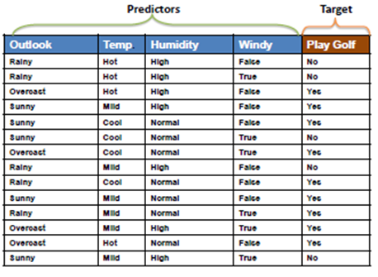

Gini Index example
1. Play = 9 days, not play = 5 days
Gini (D) = 1- (9/14)² – (5/14)² = 0.459
2.
Rainy (5 days):
Play = 2 days, not play = 3 days
Not_rainy:
play (9 days) = 7 days, not play = 2 days
Gini_{A}(D) = $\frac{\left|D1\right|}{\left|D\right|}Gini(D1)$ + $\frac{\left|D2\right|}{\left|D\right|}Gini(D2)$
Gini_{rainy} (D) = 5/14(Gini(D1))+9/14(Gini(D2))
=5/14(1-(2/5)²- (3/5)²) + 9/14(1-(7/9)²- (2/9)²)
= 0.1786 + 0.2218
= 0.4004
3. Gini (D) - Gini_{A}(D)
= 0.459 – 0.4004 = 0.055
= impurity
Implementation of Gini Index is
CART algorithm

Slide 34
Other attribute selection measures
Decision Tree Regression approach
  In regression the task instead of classifying point to one class we calculate the real value.
  Unlike calculating the information gain we calculate the variance and try to minimize it. So we split data into multiple subsets based on attributes and took one with minimum variance.
  While testing we reach the particular leaf node and took the average over all the points in that subsets and assign the average value to that testing point.
MDL (Minimum Description Length) approach

Slide 35
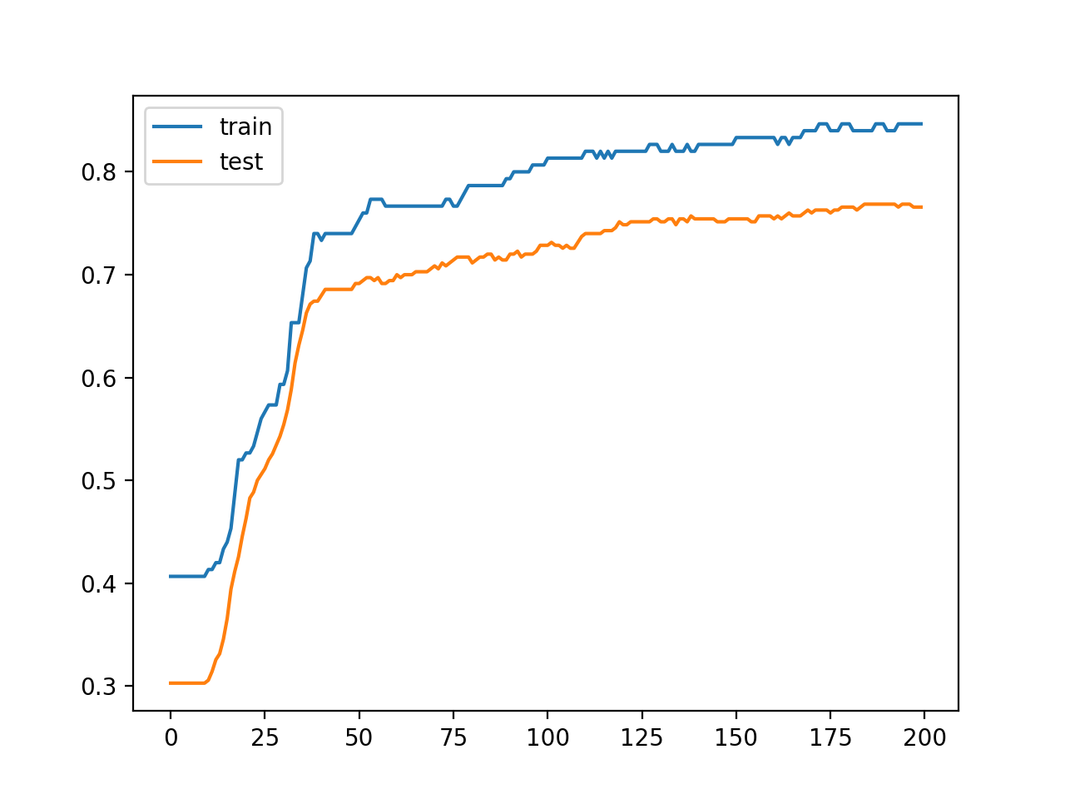
Avoiding overfitting in decision tree
Overfitting is a significant practical difficulty for decision tree models and many other predictive models. Overfitting happens when the learning algorithm continues to develop hypotheses that reduce training set error at the cost of an increased test set error.

Slide 36
Tree Pruning
Prevent overfitting to noise in the data
Two strategies:
  Post-pruning: take a fully-grown decision tree and discard unreliable parts
  Pre-pruning: stop growing a branch when information becomes unreliable
In practice, the post-pruning is the more common used strategy

Slide 37
Self-study part for your interest

Slide 38
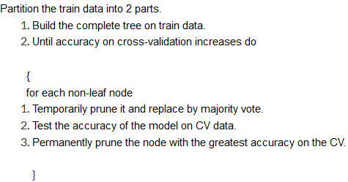
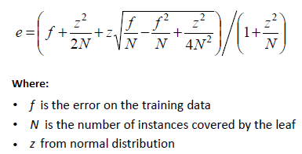
Post-pruning in detail
In post-pruning, we take training data and divide it into 2 parts. Hide the one part of data completely from the algorithm that we called as cross-validation (CV) and train a full decision tree until we get leaf nodes.
Now take out validation set and test on the learned tree which will not give 100% accuracy because the model has overfitted.
After this for each non-leaf node in the tree, we temporarily prune the node and replace it by majority class. Again test the validation set on the pruned tree we get another accuracy.
Repeat the same procedure for each non-leaf node and record the validation accuracy and took one pruned tree which will give the highest accuracy on validation data.
Error estimate function:
The other error estimate method called Chi² test
https://www.saedsayad.com/categorical_categorical.htm

Slide 39
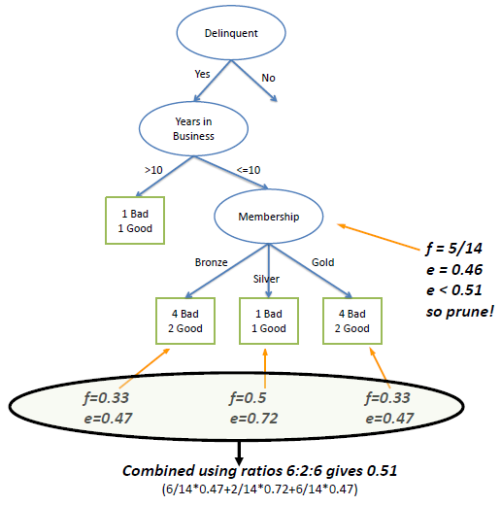
Pruning example
In the following example we set Z to 0.69 which is equal to a confidence level of 75%
2 wrong
1 wrong
2 wrong

Slide 40
Time and Space complexity
Training phase :
T (n) = O (nlogn * m) is a kind of NP hard problem (here is the prove explanation)
Where m = number of features
Testing phase:
S (n) = script of nested if-else condition
∴ S (n) = O (Total nodes)
T (n) = O (Depth)

Slide 41
Summarisation:
Pros and Cons of the decision tree
Pros:
  DT is a sequence of if-else which is highly interpretable to humans.
  It handles the irrelevant attributes easily.
  DT automatically does the multiclass classification.
  Once the DT is built it becomes very fast at the testing time.
  DT’s are very compact.
Cons:
  The decision tree may not find always the best tree because it uses the greedy approach to build the tree.
  For every large dimensional data, the training time is high.
  DT only forms axis parallel hyperplanes for a real-valued attribute.

Slide 42
Next Week
Random Forest
K-NN

Slide 43
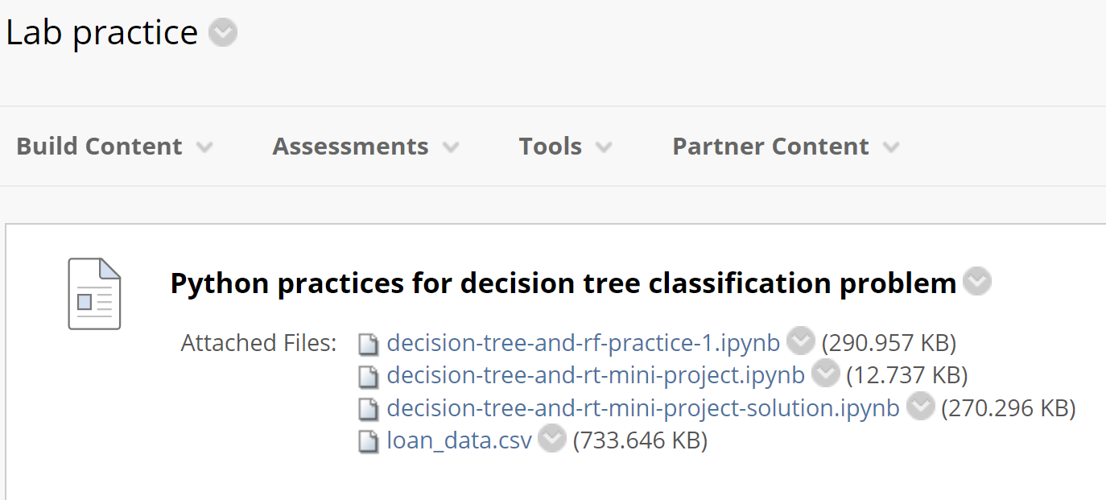
Now let’s do DT using Python
Week 4 folder – Lab practice

Slide 44
Online references
https://www.tutorialspoint.com/data_mining/dm_classification_prediction.htm
https://machinelearningmastery.com/types-of-classification-in-machine-learning/
https://www.softwaretestinghelp.com/decision-tree-algorithm-examples-data-mining/
https://www.aitimejournal.com/@akshay.chavan/a-comprehensive-guide-to-decision-tree-learning
https://www.saedsayad.com/decision_tree_overfitting.htm
https://machinelearningmastery.com/implement-decision-tree-algorithm-scratch-python/
https://stackabuse.com/decision-trees-in-python-with-scikit-learn/

